Slide 1
BLUETEETH
Business Plan
2022
BLUETEETH

Slide 2
Overview
Industry
Analysis
Competitor
Analysis
Development
Strategy
Financial
Plan
Executive Summary
Customer
Analysis
Marketing
Plan
Management
Team
BLUETEETH

Slide 3
Executive Summary
What we do
What we offer
our advantages
Our goal is to help patients and dentists find their match. Providing both parties the chance to learn about each other in advance has made the difference. We do this through our application where mutual information is shared, from patient records to professional input and educational suggestions.
Our application enables patients to easily search, access and communicate, in real time with local or national dentists or dental specialists for the purposes of consultation, introductory meetings, appointment making, and information and/or pertinent files sharing to meet their immediate dental needs.
We offer users an all in one application to engage in a more convenient and user friendly environment which allows patients to manage their oral care, and dentists to market up their services, our mission is to provide patients and dentists with information, communication and long term connection
BLUETEETH

Slide 4
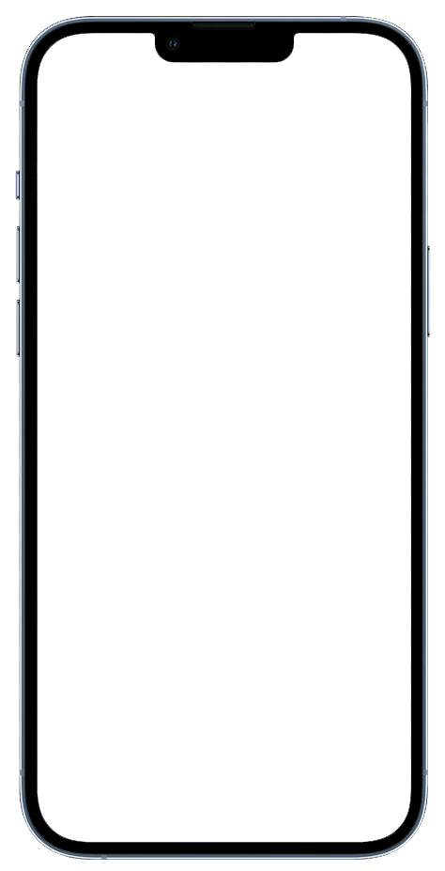
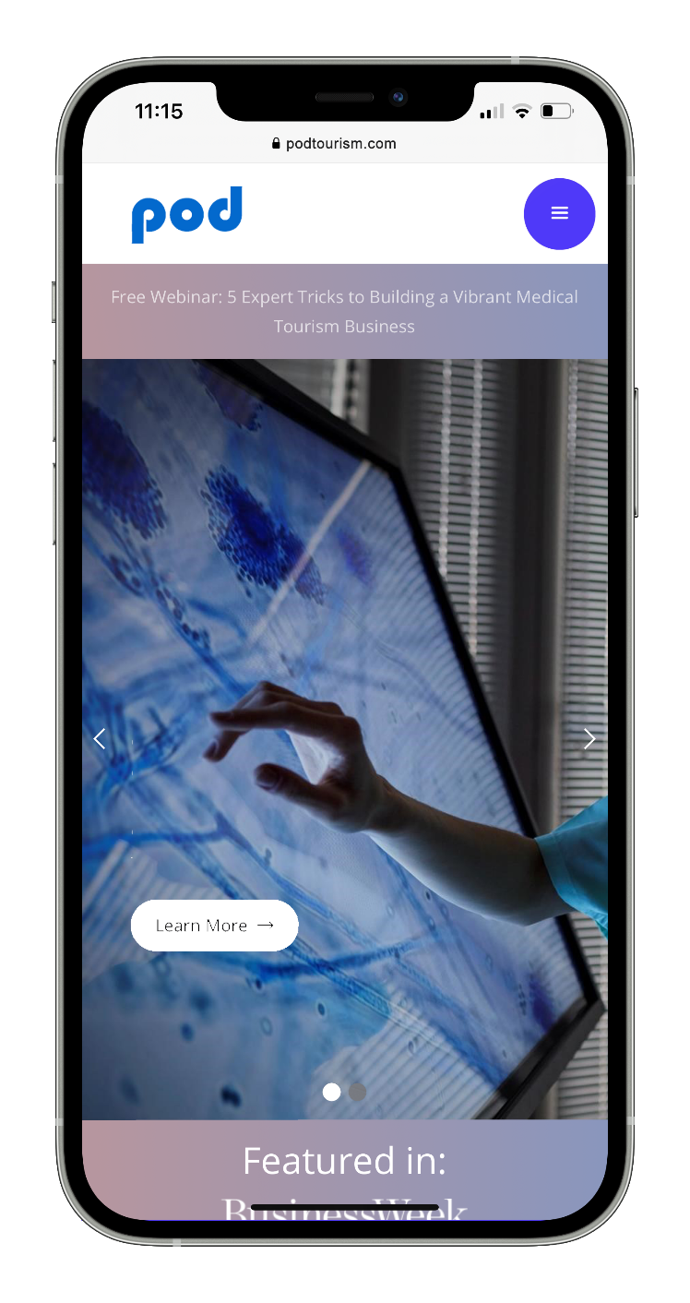

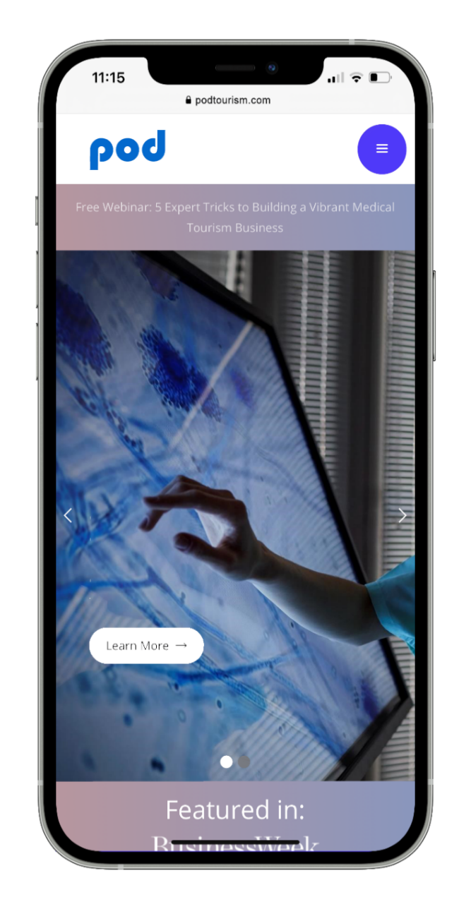

Executive Summary
Dashboard (Emergency messaging)
Custom payment method
Online video booking
bluteeth.app.com
City Hall Texas 1008
Rating and review
+1 417 985 2468
No Appointment Here
Find a dental doctor of choice and make an appointment
Messaging with patients
Book an appointment
Can save patient insurance
Reschedule Appointment
Website
Review
Patient info ( name, description)
Doctors can follow up and set appointment
Direction
BLUETEETH
Integrate with 60 PMSs to sync patient records
Marketing boost for doctors

Slide 5
Industry Analysis
$159.7 bn.
$4.9 bn.
+201 K
Market size
DPMS Market
Dentists
measured by revenue of the Dentists industry in 2022
DPMS market Worth $4.9 Billion by 2030
Number of active dentists in USA
BLUETEETH

Slide 6


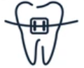
Industry Analysis
The market size of the Dentists industry is expected to increase 2.9% in 2022.
188,344 Dentists Businesses in the US in 2022
1.9% Dentists in the US Business Growth in 2022
At least 1500 active patients per doctor
every active patient will be seen every 24 weeks on average.
there will be 67 dentists for every 100,000 people in the United States by 2040, with 67% of dentists being under the age of 55 years
USA
Oral Surgery
Orthodontics
General Dentistry
6,313
10,527
130,540
BLUETEETH

Slide 7
Customer Analysis
Perfect Patients
62% are general dentistry
51% have 1-4 employees
The wealthiest of any persona
Skews older (60% are over age 50)
Balanced men and women
30%
Responsible Patients
8% are orthodontics and oral surgery
20% with job title office manager
One-third don’t have dental benefit
Most women of any persona (65%)
middle aged (60% are between 35 and 65)
21%
there will be 67 dentists for every 100,000 people in the United States by 2040, with 67% of dentists being under the age of 55 years.
Detached Patients
Almost all make more than $40K
Skews younger (majority are 35-49)
Slightly more likely to be a man (55%)
15%
BLUETEETH

Slide 8

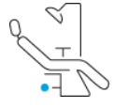

Marketing Strategy - Dentists
First Category | California, Texas, New York | All types, $2.5-500 Million, 20-5000 employees | Owner, President, VP
Second Category | Florida, Illinois Pennsylvania | All types, $500k-2.5 Million, 5-19 employees | Office Manager, Director
Third Category | Ohio, Washington, Virginia | All types, Less than $500k , 1-5 employees | Office Manager, Director
Subject
Geographic
Dentists type
Decision makers
Categories
Top State
Sale/Number of employees
Related Industries
Best contact person
BLUETEETH
Based on 7Ps model

Slide 9
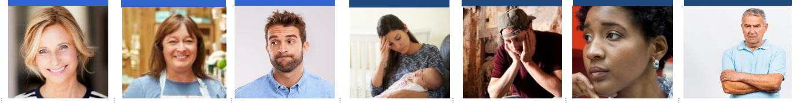


Marketing Strategy - Patients
The dental users
The dental non-users
30%
21%
15%
10%
8%
8%
7%
Perfect
Responsible
Detached
Stressed-Out
Burdened
Fearful
Not Necessary
Responsibility
Vanity
Insured
Informed
Responsibility
Support from loved ones
Insured
Drivers
-
-
-
-
None
Financial (Beyond what benefit covers)
Time
Compelling priorities
Emotional fears
Financial
Time
Financial
Emotional fears
Financial
Time
Uninformed
Lack of value on prevention
Age
Barriers

Slide 10
Marketing Strategy
Low
Detached
Low
Perfect
Texas
Illinois
Not Necessary
Rational barrier
(Financial, time,…)
Geographic Barrier
(State, Financial, Types,…)
Florida
California
Responsible
Stressed-out
New York
Pennsylvania
Fearful
Burdened
High
High
c
High
Low
High
Low
Perception barriers
(pain, bad new, time,…)
Sale Volume Barrier
(Number of employees, Salary,…)
BLUETEETH
Based on 7Ps model – MATLAB simulation

Slide 11
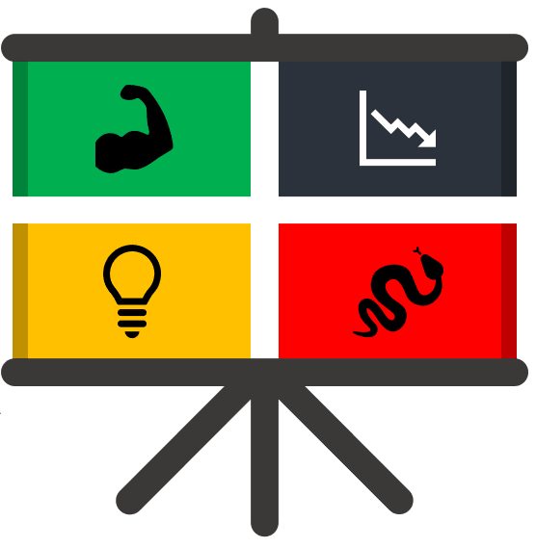
Business Strategy – SWOT analysis
Strengths
Weaknesses
Self-built technical team
Low cost production
Access to over 60 PMS
Unique marketing plan
Long distance team build up
Cash constraint
Opportunities
SO Strategies
WO Strategies
US dental market has a large volume
There is no cost benefit company
Producing an application
Raising fund for development
Participating in conferences
Register company in US
Run the app in co-founders clinics
Threats
ST Strategies
WT Strategies
Lack of patient loyalty
Restrictive regulations
Cost increases
Focus on the R&D development
In-house production
Add new features
Finding new investors
Reducing prices in order to be more competitive
BLUETEETH

Slide 12
Business Strategy – QSPM and Strategy matrix
Strategies
Market development
Market penetration
Product Development
Horizontal integration
Divestiture
Liquidation
10
Market development
Market penetration
Product development
Forward integration
Backward integration
Horizontal integration
Related diversification
Score
8
Develop doctor-patient application with access more than 60 PMS in two version of android and iOS
2.578
6
4
Scale & develop doctor-patient feature in order to customize the service for doctors and patients
2.341
2
-12
-10
-8
-6
-4
-2
0
2
4
6
8
10
12
-2
Attending dental conferences in USA and Canada
2.129
-4
Retrenchment
Related diversification
Unrelated diversification
Divestiture
Liquidation
-6
Related diversification
Unrelated diversification
Joint ventures
Establish partnership with PMSs and other channel managers
2.084
-8
-10

Slide 13
Business Strategy – Competitors
Blueteeth
Price
Location
Dentractive
Flex schedule
Dentalintel
Features
Support
Solutions
Sales channel
Functionality
Quality
BLUETEETH

Slide 14
Business Strategy – Competitors
Competitor Advantages
Ability to Produce software at the lowest cost
Access to more than 60 PMSs system that are restricted from competitors
Highly skilled software team
Unique geographic location
Presence of two dentists in management team
Flexibility in order to add more features
Customizing services per dentists
BLUETEETH

Slide 15
Business Strategy – Business model
Key Partners SIKKA Dental health businesses Dental PMSs Dentists Investor | Key Activities Design and production of Application Distribution and advertising Application Application support Social responsibility Collecting data Review and link PMS services together Partner and stakeholder management | Value Propositions Patients Easy access to the list of dentists Easy access to booking appointment Ability to select and receive dental services Transparent access to various dental expenses and data Dentists Access to patients and clients from all over the world and Ability to provide medical services online Ability to introduce activities and offices and increase the number of customers Access to patient records Manage patient-doctor relationship Enhanced marketing tool Get services at a much lower cost | Customer Relationships Long-term and short-term communication Long-term follow-up of the applicant's dental health status Pursue receiving services in the short term Communication with customers is automatic and personalized Retain the current applicant and attract new applicants Informal communication system Build trust to provide standard services Price transparency Behavior and risk management | Customer segments Dentists PMSs Patients Dental Clinics Dental Hospitals
 | Key Resources Application designers Employees Investor Medical Council PMS Companies Dental communities Responsive operators APIs brand |  | Channels Email SMS Phone website Social media Dental Ecosystems Website Dental campaigns and exhibitions Word of mouth ads App store Google play ADA advertisement
Cost Structure One-time payment: software and hardware systems, desks and chairs, platform design and production costs Permanent: marketing and advertising costs, support, maintenance and bug fixes, callback operators, utilities, transportation, internet, corporate location, staff salaries, CRM Variable: consulting, service outsourcing |  |  | Revenue Streams Charge dentist per patient Charge dentist by activation Charge dentist by service

Slide 16
Business Strategy – Mission, Vision, Value
Mission
Vision
We offer the highest quality products and services in the dental industry in the USA to provide services to patients around the USA and enable them to get the treatment they need at the lowest price, in the best way and with the highest quality. By using the business knowledge available in the dental industry, we provide trained human resources, software tools, and quality practices with international standards.
To be a broad marketing solution at the same time the best app for users to manage their data and keep them more connected to their doctor in every private health practice ( vet , physiotherapy, dentistry)
Values
Provide dentist with easy to use and manage dashboard to enhance communication with their patient and improve their patient pool by keeping them loyal. Provide patient with easy to use app that ease the appointment booking process and managing their historical data in a easy to understand manner
BLUETEETH

Slide 17


Financial Plan - Data
Year | Optimistic | Possible | Pessimistic
1st year | 4.8% | 2.4% | 0.8%
2nd year | 14.7% | 7.4% | 2.5%
3rd year | 30% | 15% | 5%
Description | Amount
Number of dentists in the USA | 201,927
Dentists whom use PMS % | 93%
Average number of patients per dentist (at least) | 1550
BLUETEETH

Slide 18
Financial Plan - Data
Description | 1st year | 2nd year | 3rd year
Number of dentists in the USA | 201927 | 207783 | 213809
Dentists who use PMS % | 93% | 93% | 93%
Rate of online reservation % | 50% | 55% | 66%
Average of growth rate of costs % | 20% | 20% | 20%
Attraction Rate % | 2.4% | 7.4% | 15%
Average cost per dentists | $75 | $90 | $108
Number of patients per dentist | 1550 | 1550 | 1550
Rate of patients who use the service | 10% | 10% | 10%
Average cost per patient | 40% | 40% | 40%
BLUETEETH

Slide 19
Financial Plan – Income scenarios
Year | Dentist | Patient
1st year | $338,026 | $55,887
2nd year | $1,406,097 | $193,729
3rd year | $4,219,825 | $484,498
Year | Dentist | Patient
1st year | $169,013 | $27,943
2nd year | $707,831 | $97,523
3rd year | $2,109,912 | $242,249
Year | Dentist | Patient
1st year | $56,338 | $9,314
2nd year | $239,132 | $32,947
3rd year | $649,617 | $74,586
BLUETEETH

Slide 20
Financial Plan – In/Out Flow prediction
OUTCOME | 1st year | 2nd year | 3rd year | Total
HR Costs | -$120,000 | -$240,000 | -$288,000 | -$648,000
Marketing & Advertisement Costs | -$39,000 | -$160,000 | -$470,432 | -$669,432
G&A Costs | $0 | -$50,000 | -$60,000 | -$110,000
Equipment Costs | -$282,000 | -$338,400 | -$406,080 | -$1,026,480
Total outcome | -$441,000 | -$788,400 | -$1,224,512 | -$2,453,912
INCOME | 1st year | 2nd year | 3rd year | Total
Income from Dentists | $169,013 | $707,831 | $2,109,912 | $2,986,756
Income from Patients | $27,943 | $97,523 | $242,249 | $367,716
Total Income | $196,956 | $805,354 | $2,352,161 | $3,354,472
BLUETEETH

Slide 21
Financial Plan – Cash flow prediction
CASH FLOW | 1st year | 2nd year | 3rd year
Inflow | $196,956 | $805,354 | $2,352,161
Outflow | -$441,000 | -$788,400 | -$1,224,512
Net cash flow | -$244,044 | $16,954 | $1,127,649
Cumulative cash flow | -265,044 | -248,090 | 879,560
NPV | $869,479
ROI (3 years) | 369.02%
Annualized ROI | 67.39%
Income
Outcome
BLUETEETH

